Slide 1
AI for Medicine
Lecture 03:
AI Applications in Medicine– Part II
January 23, 2023
Mohammad Hammoud
Carnegie Mellon University in Qatar

Slide 2
Today…
Last Lecture:
  AI Applications in Medicine- Part I
Today’s Lecture:
  AI Applications in Medicine- Part I
Announcement:
  Assignment 1 is out. It is due on January 30 by midnight

Slide 3
Some Applications of AI in Medicine
Diagnosing diabetic eye disease using deep learning [1]
Detecting anemia from retinal fundus images using deep learning [2]
Predicting cardiovascular risk factors from retinal fundus photographs using deep learning [3]
Performing differential diagnosis using probabilistic graphical models [4]
Extracting symptoms and their status from clinical conversations using recurrent neural networks [5]
Predicting osteoarthritis using machine learning [6]

Slide 4
Digital Health Has Become Ubiquitous
Everyday millions of people turn to the Internet for health information and treatment advice
In Australia, around 80% of people search the Internet for health information, and nearly 40% seek guidance online for self-treatment
In the US, almost two-thirds of adults search the Web for health information and roughly one-third utilize it for self-diagnosis

Slide 5
Digital Health and Search Engines
A recent study showed that half of the patients investigated their symptoms on search engines before visiting emergency departments
Search engines (e.g., Google and Bing) are exceptional tools for educating people, but they may facilitate misdiagnosis!
Some governments have even launched “Don’t Google It” advertising campaigns to urge their residents to avoid assessing their health using search engines

Slide 6
Symptom Checkers
In contrary, AI-based symptom checkers are tools that can assist patients in self-diagnosing themselves
  They are constantly and instantly available!
Studies show that more than 15 million people use symptom checkers per month, a number that is likely to keep growing
However, the utility and promise of symptom checkers cannot be materialized if they do not prove to be accurate in self-diagnosis

Slide 7
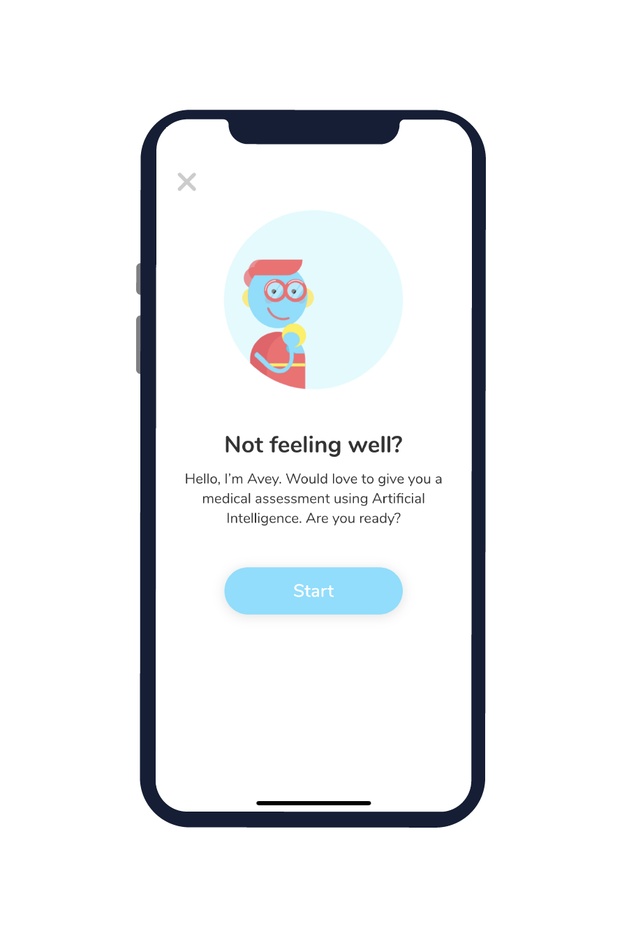
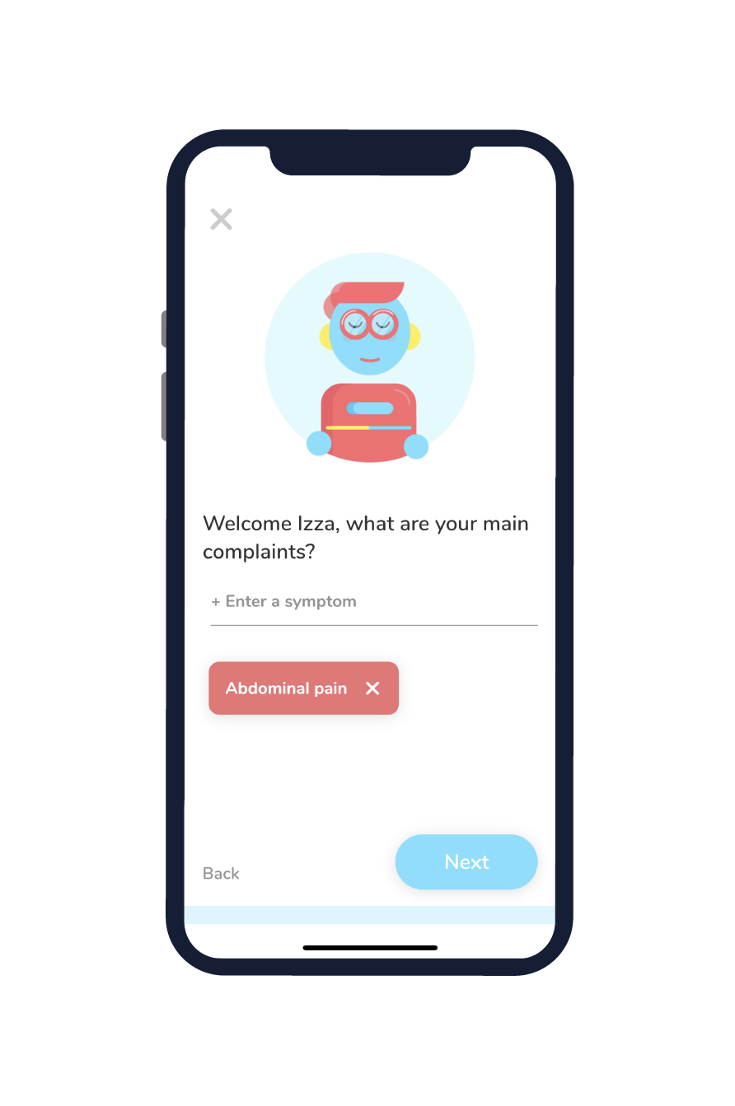
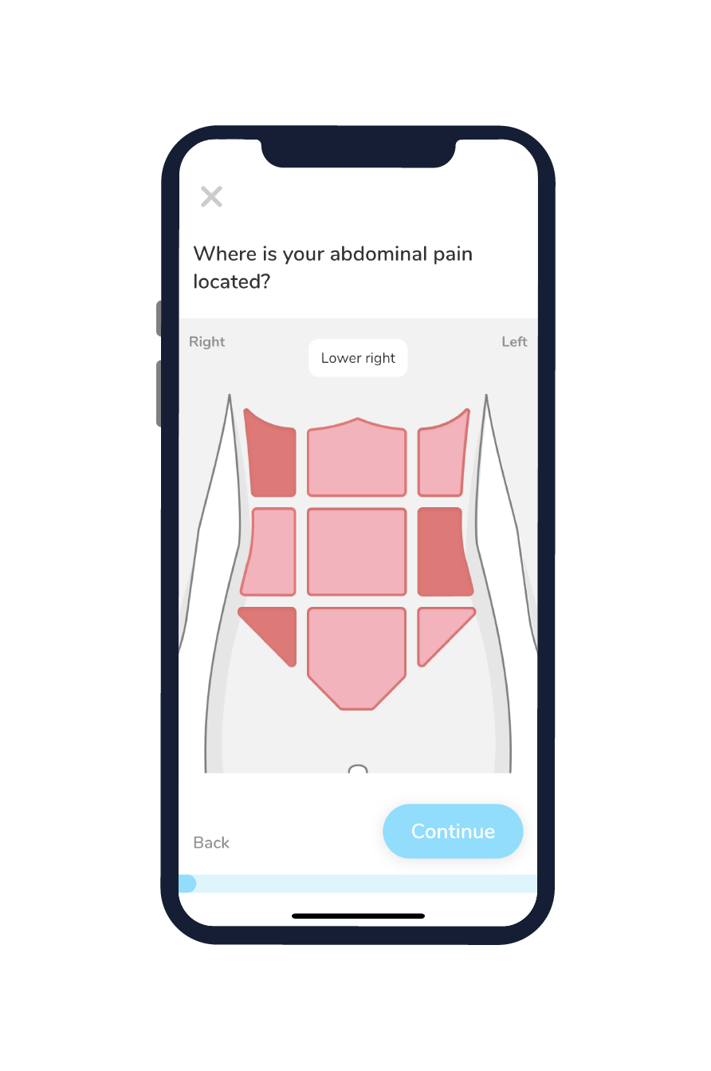
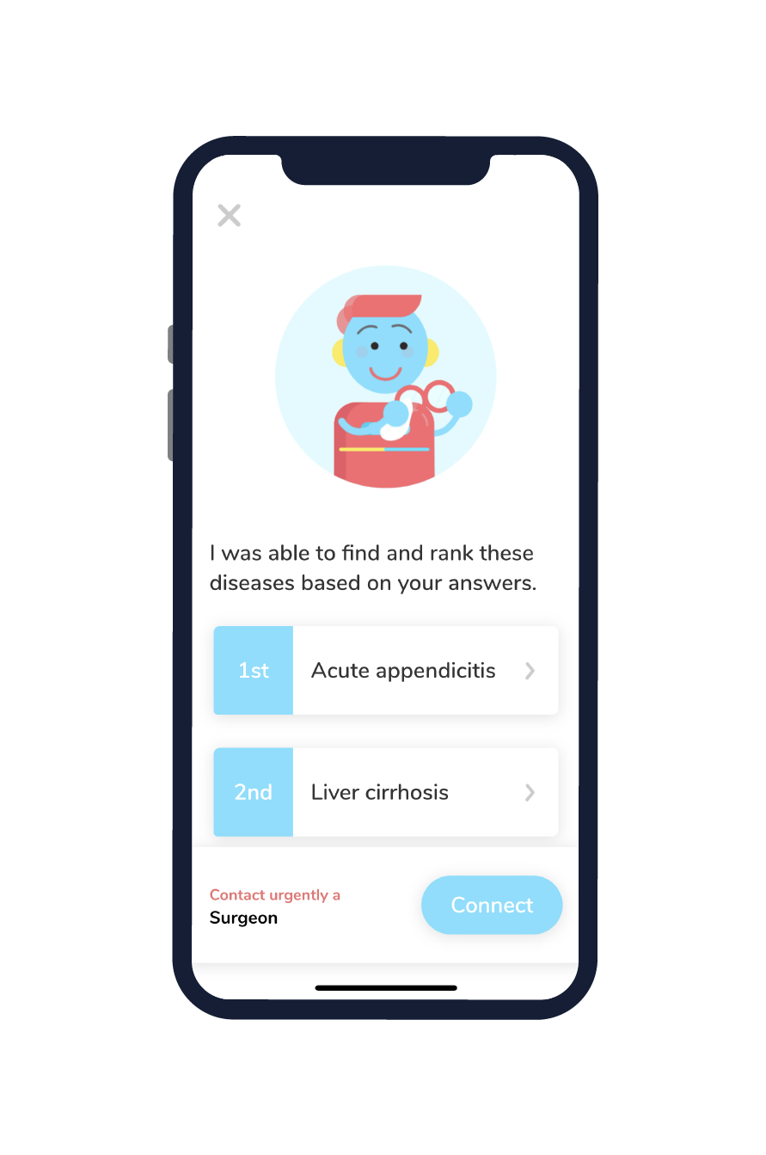
Avey: An AI-based Algorithm for Self-Diagnosis
Avey utilizes a probabilistic graphical model to provide patients with immediate and accurate self-diagnoses
. . .

Slide 8
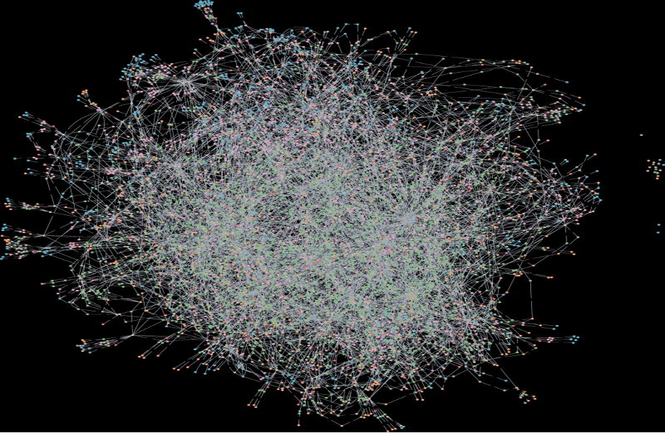
Avey: An AI-based Algorithm for Self-Diagnosis

Slide 9

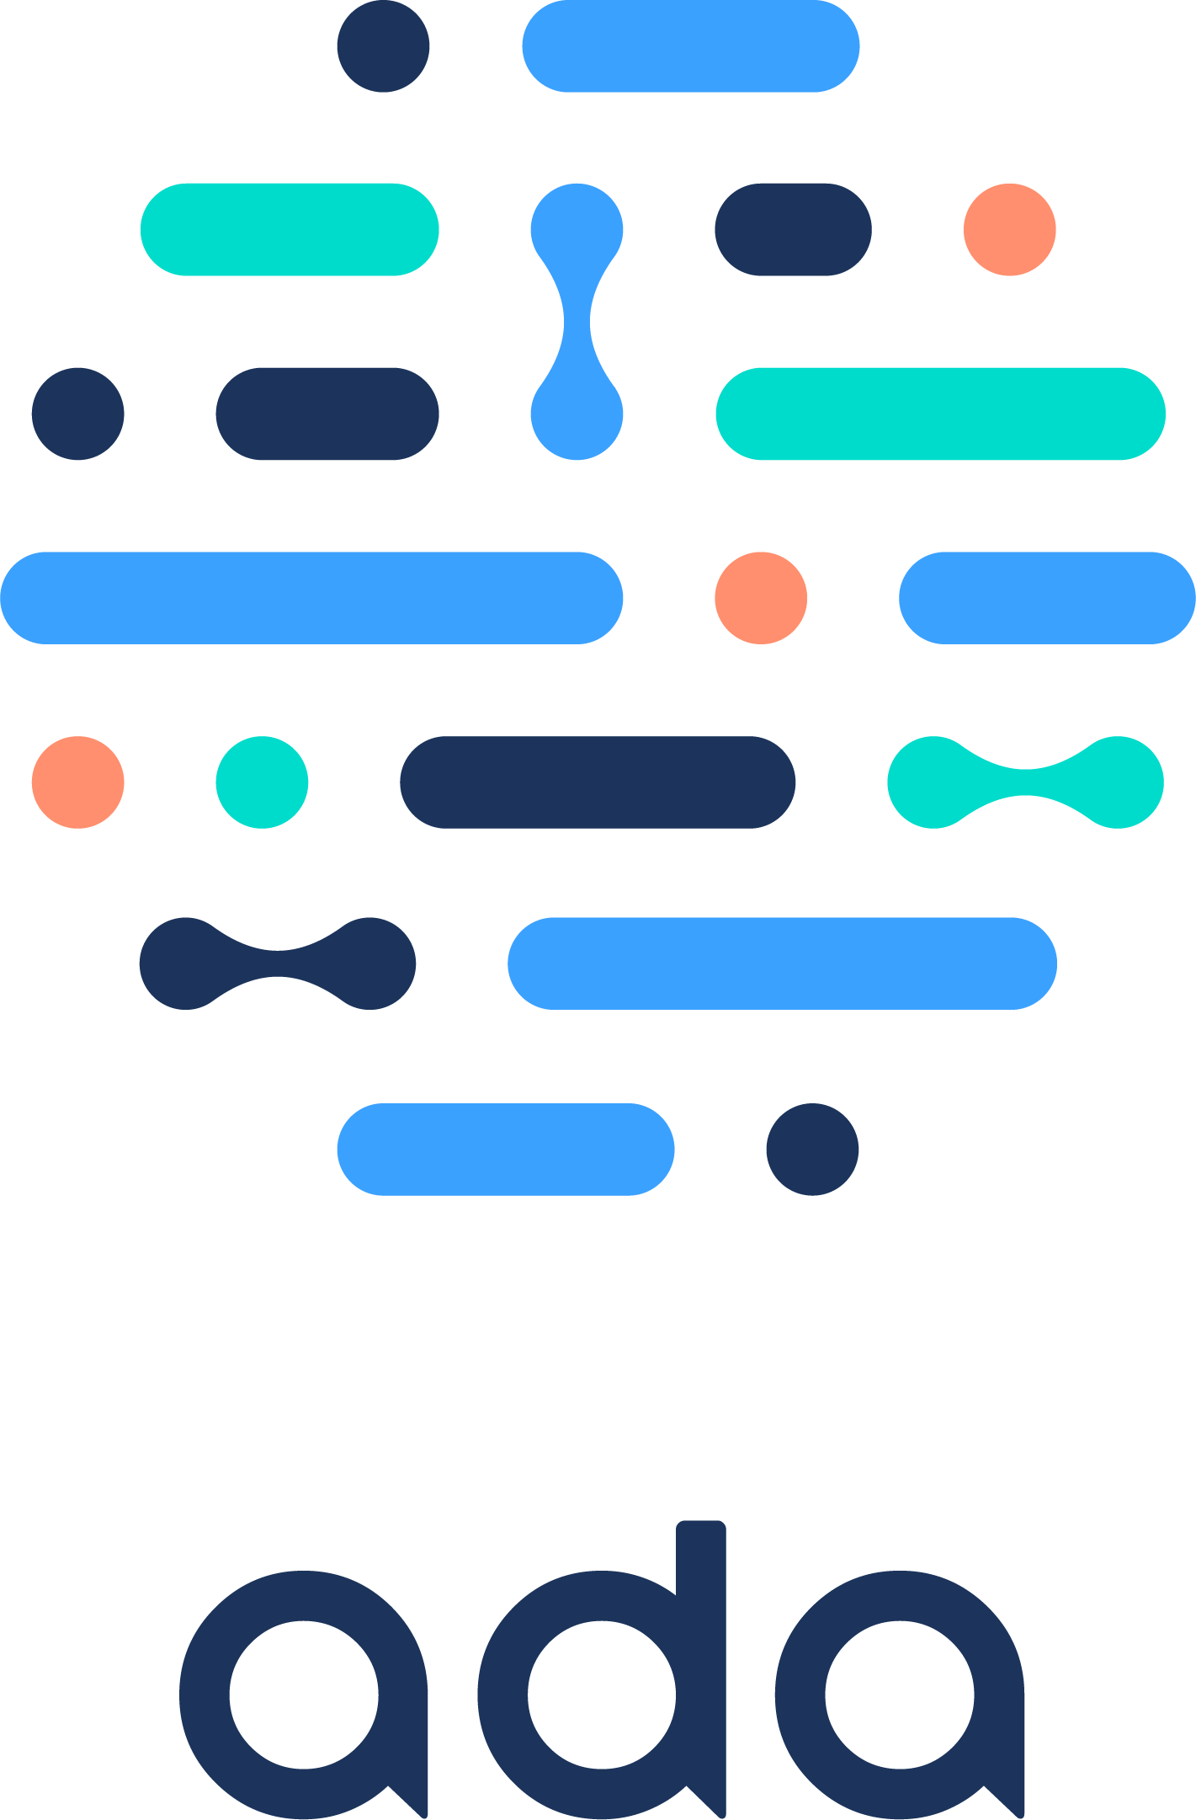


































Avey: Experimentation Methodology
Stage 1: Vingette Creation
Stage 2: Vignette Standardization
Stage 3: Vignette Testing on Checkers
D₁
$$R_{v_{1}}$$
$$R_{v_{2}}$$
…….
$$R_{v_{n}}$$
$$R_{v_{1}}$$
$$R_{v_{2}}$$
…….
$$R_{v_{n}}$$
D₂
Test Vignettes on Checkers
$$R_{v_{1}}$$
$$R_{v_{2}}$$
…….
$$R_{v_{n}}$$
V₁
V₁
Counter = 3
$$R_{v_{1}}$$
$$R_{v_{2}}$$
…….
$$R_{v_{n}}$$
V₂
D₃
V₂
Counter = 5
$$R_{v_{1}}$$
$$R_{v_{2}}$$
…….
$$R_{v_{n}}$$
.
.
.
.
.
.
.
.
.
.
.
$$R_{v_{1}}$$
$$R_{v_{2}}$$
…….
$$R_{v_{n}}$$
Medical Sources
Compile Vignettes
D₄
Pool of
Gold-Standard Vignettes
D₅
Stage 4: Vignette Testing on Doctors
D₆
$${MD}_{1}$$
$$R_{v_{1}}$$
$$R_{v_{2}}$$
…….
$$R_{v_{n}}$$
V_{n}
V_{n}
Test Vignettes on Doctors
Counter = 5
$${MD}_{2}$$
…….
$$R_{v_{1}}$$
$$R_{v_{2}}$$
$$R_{v_{n}}$$
D₇
$${MD}_{3}$$
…….
$$R_{v_{1}}$$
$$R_{v_{2}}$$
$$R_{v_{n}}$$
V_{i} = Vignette i, D_{j} or MD_{j} = Doctor j, Counter = k means that k doctors approved the vignette, R_{vi} = Result of diagnosing vignette i

Slide 10
Avey versus Other Symptom Checkers

Slide 11
Avey versus Human Doctors

Slide 12
Some Applications of AI in Medicine
Diagnosing diabetic eye disease using deep learning [1]
Detecting anemia from retinal fundus images using deep learning [2]
Predicting cardiovascular risk factors from retinal fundus photographs using deep learning [3]
Performing differential diagnosis using probabilistic graphical models [4]
Extracting symptoms and their status from clinical conversations using recurrent neural networks [5]
Predicting osteoarthritis using machine learning [6]

Slide 13
Extracting Symptoms and their Status from Clinical Conversations Using Recurrent Neural Networks
Adopting Electronic Health Records (EHR) places a disproportinate burden of documentation on physicans, causing burnout among them
  A study found that full-time primary care physicians spent about 4.5 hours of an 11-hour workday interacting with documentation systems
  Yet, they were still unable to finish their documentations and had to spend an additional 1.4 hours after normal clinical hours
Natural Language Processing (NLP) is now mature
  How can it be exploited to simplify the task of documentation and allow physicians to dedicate more time to patients?
Notes:
* This is a 2017 study (https://pubmed.ncbi.nlm.nih.gov/28893811/). They conducted a retrospective cohort study of 142 family medicine physicians in a single system in southern Wisconsin. All Epic (Epic Systems Corporation) EHR interactions were captured from "event logging" records over a 3-year period for both direct patient care and non-face-to-face activities, and were validated by direct observation. EHR events were assigned to 1 of 15 EHR task categories and allocated to either during or after clinic hours.
* NLP is concerned with programming computers to understand natural languages, whether said or written.

Slide 14
Extracting Symptoms and their Status from Clinical Conversations Using Recurrent Neural Networks
Unfortunately, there is a lack of any publicly available corpus in this privacy-sensitive domain
Google managed to develop a corpus of 90k de-identified and manually transcribed audio recordings of clinical conversations between physicians and patients
  The corpus was annotated by professional medical scribes
  It resulted in 5M tokens, 615K sentences, 92K labels, 186 symptoms, and 14 body systems
  It demonstrated a great deal of challenges!

Slide 15
Extracting Symptoms and their Status from Clinical Conversations Using Recurrent Neural Networks
Some of these challenges:
  The human scribes often disagreed on which labels to pick for which text, let alone the span of text to label
  Symptoms were sometimes not stated explicitly, but rather explained or described in informal language over several conversation turns
Transcript | Symptoms + Status
DR: Any issues with your eyes? PT: Well sort of DR: Is your vision ok? PT: Yeah, but the right one hurts | Eye pain: Experienced Vision loss: Not experienced
DR: How is your bladder? PT: I have to go, all the time DR: At night? PT: No, just during the day | Frequent urination: Experienced Nocturia: Not experienced

Slide 16
Extracting Symptoms and their Status from Clinical Conversations Using Recurrent Neural Networks
Some of these challenges:
  The human scribes often disagreed on which labels to pick for which text, let alone the span of text to label
  Symptoms were sometimes not stated explicitly, but rather explained or described in informal language over several conversation turns
Transcript | Symptoms + Status
DR: Any issues with your eyes? PT: Well sort of DR: Is your vision ok? PT: Yeah, but the right one hurts | Eye pain: Experienced Vision loss: Not experienced
DR: How is your bladder? PT: I have to go, all the time DR: At night? PT: No, just during the day | Frequent urination: Experienced Nocturia: Not experienced

Slide 17
Extracting Symptoms and their Status from Clinical Conversations Using Recurrent Neural Networks
Two Deep Learning models (one is RNN– we will discuss it later in the course) were trained over the created corpus to solve this problem
The models proved that symptoms, along with whether patients have them or not, can be inferred
  Note: It is not enough only to infer symptoms but further decide whether the patient have them or not
The performance of the models were significantly better than the baseline systems and ranged from an F-score of 0.5 to 0.8 depending on the condition

Slide 18
Some Applications of AI in Medicine
Diagnosing diabetic eye disease using deep learning [1]
Detecting anemia from retinal fundus images using deep learning [2]
Predicting cardiovascular risk factors from retinal fundus photographs using deep learning [3]
Performing differential diagnosis using probabilistic graphical models [4]
Extracting symptoms and their status from clinical conversations using recurrent neural networks [5]
Predicting osteoarthritis using machine learning [6]

Slide 19
And the Power of AI is Yet to Usher
The first medical image ever taken was in 1895 by Wilhelm Röntgen
  This allowed looking inside a human body without slicing someone open!
Since then, medical imaging has represented the fastest
growing source of medical data and literally changed the
face of medicine
Imaging can sometimes reveal a disease before we feel it
  For several diseases (e.g., cancer), the earlier we diagnose them the more likely the patients will survive, let alone reducing pain, suffering, cost, etc.

Slide 20
Discovery and Visualization of Structural Biomarkers from MRI using Machine Learning
That is why we screen people who exhibit no signs or symptoms yet
But, the earlier we capture images, the smaller & smaller the visible evidences of diseases become, until they vanish before our naked eyes
  How early can we detect diseases?
There is a growing belief that there is an invisible side to imaging!
  These are small changes (or hidden patterns) that are imperceptible to humans
  Yet, they can be detected by AI!

Slide 21
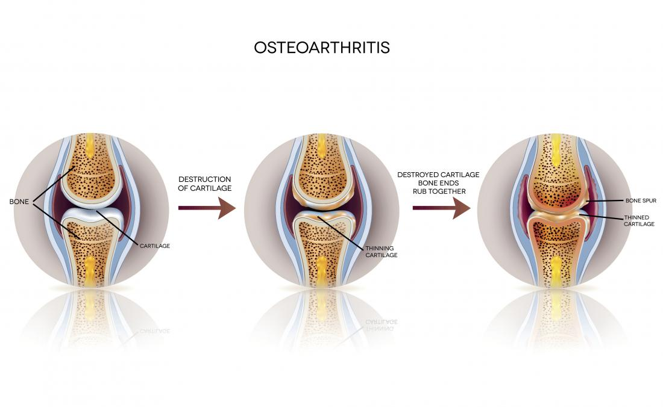
Discovery and Visualization of Structural Biomarkers from MRI using Machine Learning
One in 10 develop knee osteoarthritis, which cannot be detected until the damage has occurred
Notes:
Osteoarthritis is the most common form of arthritis, affecting millions of people worldwide. It occurs when the protective cartilage that cushions the ends of your bones wears down over time.
Although osteoarthritis can damage any joint, the disorder most commonly affects joints in your hands, knees, hips and spine.
There is an evidence that the disease begins long before inside the cartilage. So why not looking inside the cartilage to diagnose the disease?

Slide 22
Discovery and Visualization of Structural Biomarkers from MRI using Machine Learning
Here are scans that belong to different subjects, with different colors representing different ingredients that make up the cartilage
Group A
Group B
Which group has osteoartherits? Best experts cannot tell!

Slide 23
Discovery and Visualization of Structural Biomarkers from MRI using Machine Learning
Here are scans that belong to different subjects, with different colors representing different ingredients that make up the cartilage
Group A
Group B
NO osteoarthritis in 3 years
Osteoarthritis in 3 years

Slide 24
Discovery and Visualization of Structural Biomarkers from MRI using Machine Learning
This can be predicted using a machine learning algorithm that applies a technique known as “transport based morphometry”
The algorithm is able to predict whether a person will develop osteoarthritis 3 year down the line with an accuracy of 86.2%
The algorithm can learn more with experience, hence, it will only get better and better as we feed it with more scans

Slide 25
Discovery and Visualization of Structural Biomarkers from MRI using Machine Learning
But what does this algorithm see that doctors cannot?
  The diffusion of water
The pooling of water at the center of the
cartilage suggests that there is a weakening
of cartilage at that location
Water is evenly distributed throughout the cartilage

Slide 26
Discovery and Visualization of Structural Biomarkers from MRI using Machine Learning
This can augment our capability and help us identify new targets for treatments
Can we apply this technique to other diseases (e.g., Alzheimer, autism, schizophrenia)?
  If so, can we halt them before they even begin?
Just like in 1985 when the first image was taken, the face of medicine is about to change again
  At that time we were able to see the visible
  Now, we can see the invisible through AI!

Slide 27
Next Class…
Information Retrieval – Part I

Slide 28
References
Gulshan, Varun, et al. "Development and validation of a deep learning algorithm for detection of diabetic retinopathy in retinal fundus photographs." Jama 316.22 (2016): 2402-2410.
Mitani, Akinori, et al. "Detection of anaemia from retinal fundus images via deep learning." Nature Biomedical Engineering 4.1 (2020): 18-27.
Poplin, R., et al. "Predicting cardiovascular risk factors from retinal fundus photographs using deep learning.” arXiv preprint arXiv:1708.09843.
Hammoud, M., et al. “Avey: An Accurate AI Algorithm for Self-Diagnosis.” medRxiv 2022
Du, Nan, et al. "Extracting symptoms and their status from clinical conversations." arXiv preprint arXiv:1906.02239 (2019).
Kundu, Shinjini, et al. "Discovery and visualization of structural biomarkers from MRI using transport-based morphometry." NeuroImage 167 (2018): 256-275.

